Slide 1
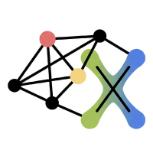





Tutorial: GNN Explainers 2.0: User-centric and Data Driven Insights
Arijit Khan, Xiangyu Ke, Yinghui Wu, Francesco Bonchi

Slide 2
Introduction
Arijit Khan
2

Slide 3
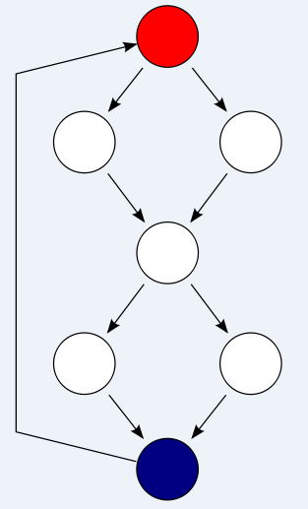
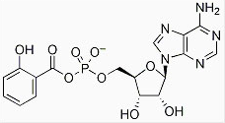
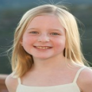

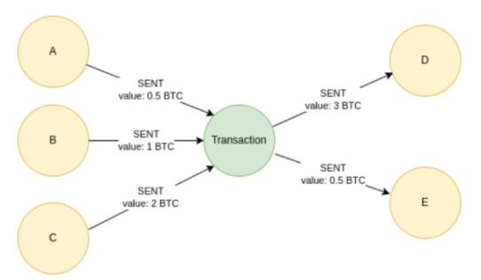







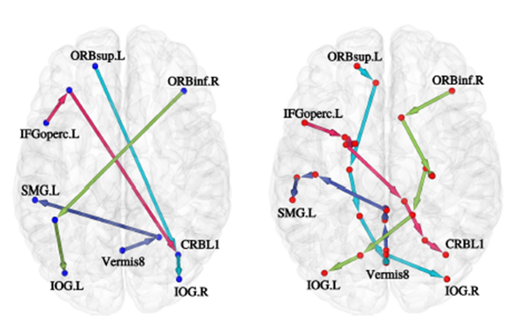
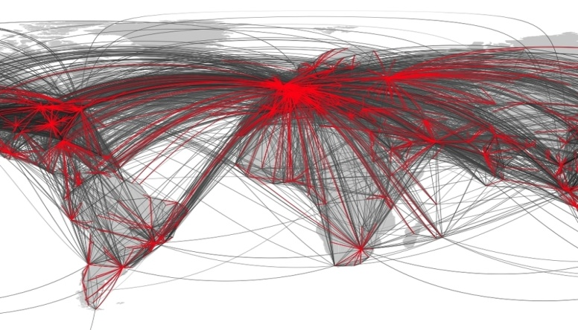
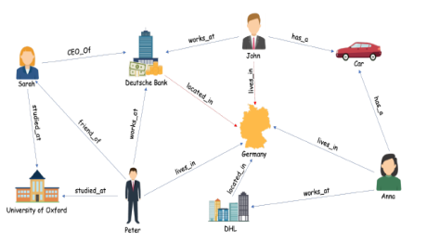
Graph data is everywhere
Graph database with many smaller graphs
One large graph
Chemical compound structure
Program flow/ call graph
Financial transaction
Social network
Knowledge graph
Human brain network
Transportation
3

Slide 4

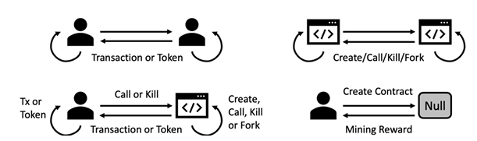
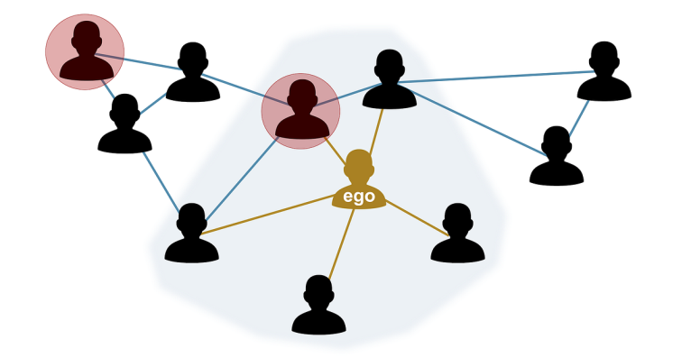
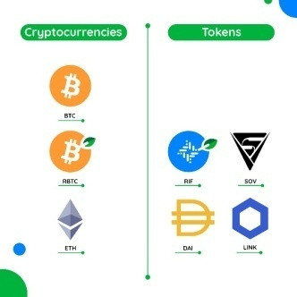
Graph data is everywhere
One large graph
Social network
Financial transaction
Graph database with many smaller graphs
Individual token and coin networks
Ego network of individual users
4

Slide 5
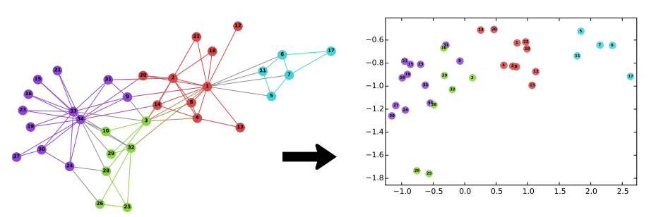



Graph neural network (GNN): Key idea
v
Downstream tasks (e.g., graph and node classification,
recommendation, link prediction, question answering)
f(v) = R^{d}
Representation learning or embedding
Learning could be end-to-end
A
End-to-end learning →
Task-independent / task-dependent learning.
Can capture graph structure and node, edge features.
B
agg
C
B
A
A
C
agg
B
A
com
C
E
Graph Convolutional Neural Network (GCN)
D
F
F
Massage passing to use aggregation and combine functions repeated several times.
E
D
agg
A
Input graph
Technique in GCN
Representation Learning on Networks (WWW Tutorial, 2018)
5

Slide 6





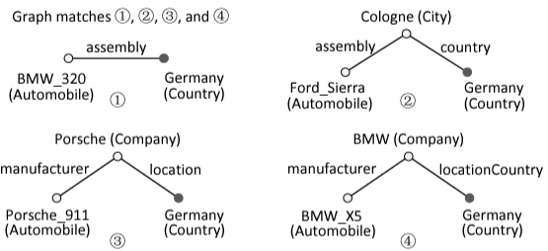
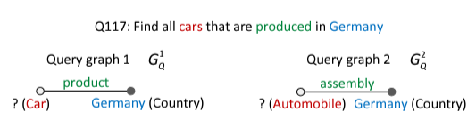
Graph neural network (GNN): Downstream tasks
Node classification
Recommendation
Node-level task
?
Entity resolution
?
?
Germany (country)
Germany (country)
Audi AG (company)
Graph classification
location
Graph-level task
Volkswagen (company)
assembly
manufacturer
manufacturer
?
Originated_from
Audi TT (automobile)
? Mutagen
?
Audi Tourist Trophy
(automobile)
VW (company)
? Non-mutagen
Knowledge graph 1
Knowledge graph 2
Question answering
Link prediction
Edge-level task
Drug design
?
predicting missing links between drug and disease.

Slide 7
Graph Neural Network (GNN): Explainability [IEEE DSAA 2023 Tutorial]
Explain the results of high-quality GNNs.
[Instance-level] Understand which aspects of the input data drive the decisions of the GNN – discover critical nodes, edges, subgraphs, and their features that are responsible for GNN outcomes.
[Model-level] Insight on how GNNs work – discover what input subgraph patterns lead to a certain prediction.
Importance
Desirable to understand and explain the workings and results of black-box GNNs – bridge domain knowledge with GNN predictions, human-AI collaboration.
Safety and well-being (e.g., autonomous car, AI in healthcare) – trust in deep learning models.
Understand bias in machine learning (ML) algorithms – ML algorithms can amplify bias, model debugging.
Robustness against adversarial examples – improve quality of GNN outputs.
Legal requirements, e.g., GDPR – algorithms to explain their outputs.
Scientific applications – identify hidden patterns, rules, root causes, discover laws in science (biology, physics, chemistry, social science, etc.)
Stakeholders
End users, domain experts, decision makers, policy makers, regulatory agencies, researchers, data scientists, and engineers
7

Slide 8
Challenges with GNN Explanations
Many definitions, motivations, and requirements for explainability.
– trust, causality, transferability, informativeness, fair and ethical decision making, model debugging, recourse, mental model comparison, context-dependent, low-level mechanistic understanding of models, high-level human understanding, what makes users confident about the model.
Comparing explanations is hard!
Several quantitative and qualitative evaluation metrics or methods.
– Quantitative: faithfulness (fidelity+, fidelity-), sparsity, contrastivity, accuracy, stability.
– Qualitative: application-grounded, human-grounded, and functionally-grounded evaluation.
Difficult to obtain ground-truth.
Security and privacy concerns.
Other issues: Evaluation via occlusion creates data outside training distribution, bias terms, redundant evidence, trivial correct explanations, weak GNN model, misaligned GNN architecture, problems due to graph data vs. grid data.
Capture interplay of graph structure and features in GNN’s decision making.
8

Slide 9
Challenges with GNN Explanations
Many definitions, motivations, and requirements for explainability.
– trust, causality, transferability, informativeness, fair and ethical decision making, model debugging, recourse, mental model comparison, context-dependent, low-level mechanistic understanding of models, high-level human understanding, what makes users confident about the model.
Comparing explanations is hard!
Several quantitative and qualitative evaluation metrics or methods.
– Quantitative: faithfulness (fidelity+, fidelity-), sparsity, contrastivity, accuracy, stability.
– Qualitative: application-grounded, human-grounded, and functionally-grounded evaluation.
USER-FOCUSED EXPLANATION: “Ability to explain or to present a model in understandable terms to humans”
Doshi-Velez and Kim 2017
Difficult to obtain ground-truth.
Security and privacy concerns.
Other issues: Evaluation via occlusion creates data outside training distribution, bias terms, redundant evidence, trivial correct explanations, weak GNN model, misaligned GNN architecture, problems due to graph data vs. grid data.
Capture interplay of graph structure and features in GNN’s decision making.
9

Slide 10
Interpretability vs. Explainability
Often used interchangeably.
Interpretability concerns the understanding (of inner workings) of the model by AI experts and researchers, while explainability focuses on explaining the decisions made to end users.
We focus on GNN Explainability
10

Slide 11

Tutorial outline
1 Introduction
1.1 Graph neural networks (GNNs) and applications
1.2 Explainability of GNNs
- Definitions, importance, and challenges
2 GNN Explainers Categorization
3 GNN Explainers 2.0
4 User-centric and Data-driven Explainability Methods for GNNs
5 Future directions
11

Slide 12

Tutorial outline
1 Introduction
2 GNN Explainers Categorization
2.1 Post-hoc vs. intrinsic / self-explainable
2.2 Global vs. local
2.3 Class-specific vs. instance-specific
2.4 Model-specific vs. model-agnostic
2.5 Forward vs. backward
2.6 Node-level vs. edge-level vs. subgraph-level
2.7 Perturbation vs. gradient vs. decomposition vs. surrogate models
2.8 Factuals vs. counterfactuals
3 GNN Explainers 2.0
4 User-centric and Data-driven Explainability Methods for GNNs
5 Future directions
12

Slide 13
GNN Explainers Categorization
Arijit Khan
Explainability in Graph Neural Networks: A Taxonomic Survey.
Hao Yuan, Haiyang Yu, Shurui Gui, Shuiwang Ji. IEEE Transactions on Pattern Analysis and Machine Intelligence, Volume 45, Issue 5, Pages 5782 - 5799, 2023.
Jaykumar Kakkad, Jaspal Jannu, Kartik Sharma, Charu Aggarwal, Sourav Medya. A Survey on Explainability of Graph Neural Networks. IEEE Data Eng. Bull. 47(2): 35-63 (2023)
13

Slide 14
Post-hoc vs. Intrinsic Explainability Methods
We’ll focus on them
Post-hoc. Creating a second model/ algorithm to provide explanations for an existing GNN model.
- e.g., perturbation-based approaches (GNNExplainer, NeurIPS2019).
- could be limited in explanation performance (e.g., reporting spuriously-correlated features with the task), while keeping the underlying GNN accuracy intact.
Intrinsic / self-explainable. Constructing self-explanatory models which incorporate explainability directly to their structures.
- e.g., use structural constraints to derive an informative subgraph which is used for both prediction and explanation.
- e.g., graph attention networks (ICLR 2018), SEGNN (CIKM 2021), ProtGNN (AAAI 2022).
- trade-off between good explainability vs. prediction accuracy.
14

Slide 15
Global vs. Local Explainability Methods
Global. Explain the overall behavior of the model, e.g., XGNN (KDD 2020), PGExplainer (NeurIPS 2020), PGM‑Explainer (NeurIPS 2020), GraphMask (ICLR 2021).
Provide model‑level summaries.
Capture common structural motifs, feature importance trends, or decision rules
- Often approximate the model with a simpler surrogate (e.g., rule sets, prototypes)
Local. Explain the reasoning behind a specific prediction, e.g., GNNExplainer (NeurIPS 2019), SubgraphX (ICML 2021), CF‑GNNExplainer (AISTATS 2022).
- Provide instance‑level explanations.
- Highlight subgraphs, features, or neighbors that influenced one prediction.
- Often produce masks, saliency maps, or counterfactuals.
15

Slide 16
Class-specific vs. Instance-specific Explainability Methods
Class-specific. Explain what the model considers important for predicting a particular class, e.g., XGNN (KDD 2020).
- Aggregate explanations across many instances of the same class.
- Produce class‑level prototypes, motifs, or feature sets.
- Useful for fairness, consistency, and debugging class boundaries.
Instance-specific. Explain the prediction for one specific instance., e.g., GNNExplainer (NeurIPS 2019), SubgraphX (ICML 2021), CF‑GNNExplainer (AISTATS 2022).
- Provide explanations tailored to a single sample.
- Often produce subgraph masks, feature attributions, or counterfactuals.
- Sensitive to local neighborhood and feature perturbations.
16

Slide 17
Model-specific vs. Model-agnostic Explainability Methods
Model-specific / white-box. Requires access to internal model parameters or embeddings to provide explanations.
e.g., gradient-based methods calculate the gradient of an output w.r.t. the input using backpropagation to derive the contribution of features (Explainability methods for graph convolutional neural networks. in CVPR, 2019).
Gradient-based methods are more efficient, since they usually need one forward and another backward pass.
Issues: gradient saturation, ..
Model-agnostic / black-box. Does not require internals of the GNNs to generate explanations.
e.g., perturbation-based methods (GNNExplainer, NeurIPS 2019) determine the contribution of a feature by measuring how prediction score changes when the feature is altered.
can be computationally inefficient as each perturbation requires a separate forward propagation through the network.
17

Slide 18
Forward vs. Backward Explainability Methods
Forward interpretability methods. GNN model-agnostic, learn evidence about graphs or nodes passed through the GNN.
e.g., perturbation-based, that is, masking some node features and/ or edge features and analyzing the changes when the modified graphs are passed through the GNN model.
e.g., employ a simple, interpretable surrogate model to approximate the predictions of a complex GNN.
Backward interpretability methods. GNN model-specific.
- e.g., gradient-based – backpropagating importance signal from the output neuron of the model to the individual nodes of the input graph.
- e.g., decomposition-based – distributing the prediction score in a backpropagation manner until the input layer.
18

Slide 19
Node-level vs. Edge-level vs. Subgraph-level
Explainability Methods
Output of explainability methods. Node / node feature, edge, subgraph.
Node / node feature. E.g., ZORRO, IEEE Transactions on Knowledge & Data Engineering. 35(8), 2023.
Edge. E.g., PGExplainer, NeurIPS 2020.
Subgraph. E.g., SubgraphX, ICML 2021.
19

Slide 20
Counterfactual vs. Factual Explainability Methods
Factual Explanation. Finding a subgraph whose information is sufficient to lead to the same prediction for the input sample. E.g., GNNExplainer, NeurIPS 2019.
Counterfactual Explanation. Finding a subgraph whose information is necessary hence its removal will result in different predictions (i.e., necessary subgraph for the targeted class). E.g., GCFExplainer, WSDM 2023.
Factual and Counterfactual Explanation. Finding a subgraph that follows both the factual and counterfactual reasoning; finding a subgraph that outputs the same prediction and its absence will cause changes on the output of the model. E.g., CF², WWW 2022.
20

Slide 21
Different Explainability Methods for GNNs (Instance-Specific)
Perturbation-based. Masking some node features and/ or edge features and analyzing the changes when the modified graphs are passed through the GNN model. E.g., GNNExplainer, NeurIPS 2019.
Surrogate model. Employs a simple, interpretable surrogate model to approximate the predictions of a complex GNN. E.g., PGM-explainer, NeurIPS 2020.
Gradient-based. Backpropagating importance signal from the output neuron of the model to the individual nodes of the input graph. E.g., Grad-CAM (Explainability methods for graph convolutional neural networks. in CVPR, 2019).
Decomposition-based. Distributing the prediction score in a backpropagation manner until the input layer. E.g., LRP, TextGraphs 2019.
21

Slide 22
Different Explainability Methods for GNNs (Global)
Generation-based. Graph generator generates example graph patterns that maximize the prediction probability of each class. E.g., XGNN, KDD 2020.
Global counterfactuals-based. Find a small set of representative counterfactual graphs that explains all input graphs. E.g., GCFExplainer, WSDM 2023.
Global concept-based. GNN neurons as global concept detectors. E.g., Global concept-based interpretability for graph neural networks via neuron analysis, AAAI 2023.
22

Slide 23
Tutorial outline
1 Introduction
2 GNN Explainers Categorization
3 GNN Explainers 2.0
4 User-centric and Data-driven Explainability Methods for GNNs
5 Future directions
23

Slide 24
GNN Explainers 2.0
Arijit Khan
24

Slide 25

Limitations of SOTA GNN Explainers
GNN Explainers 1.0; e.g., GNNExplainer, PGExplainer, SubgraphX, PGMExplainer, GraphLime, GCFExplainer, CF2, GNN-LRP)
Explaining model behavior
One-off explanations of the model’s final output
Less interactive, less user-focused
Task-limited, e.g., mainly for node and graph classification
25

Slide 26
User-centric and Data-driven Explanations
GNN Explainers 2.0
Explanations for end-users and domain experts
Layer-wise provenance for model debugging and optimization
Interactive, configurable, efficient, and scalable explanations
Robust and multi-criteria optimization explanations
Explanatory query and output interface based on structured query, natural language, and examples
26

Slide 27
Tutorial outline
1 Introduction
2 GNN Explainers Categorization
3 GNN Explainers 2.0
4 User-centric and Data-driven Explainability Methods for GNNs
4.1 Pattern Mining and Concept Hierarchies
4.2 Model-slicing Explanations
4.3 Robust Explanations
4.4 Multi-criteria Explanations
4.5 Declarative Explanatory Queries
4.6 Efficiency and Interactiveness
4.7 Natural Language Explanations
4.8 Counterfactual Explanations
5 Future directions
27

Slide 28
Pattern Mining and Concept Hierarchies
Xiangyu Ke
28

Slide 29
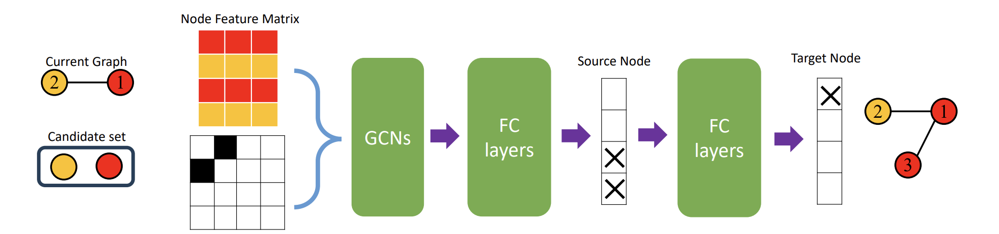
Pattern Mining and Concept Hierarchies
Current explanations usually emphasize numerical logits or feature scores over many domain-specific structures, making explanations hard to interpret, access, and adapt for downstream use.
Pattern mining and concept hierarchies are powerful complements to GNN explainability, because:
Raise abstraction level: Node-level saliency or edge importance is low-level and noisy. Mining frequent structural patterns and grouping them into concepts gives explanations at human-meaningful levels.
Stability: Patterns aggregated over many examples are less sensitive to small perturbations.
Compression / interpretability: A compact set of concepts/patterns summarizes many instance-level explanations, reducing cognitive load for humans.
Causal / semantic insight. When patterns align with domain concepts (e.g., protein binding sites, fraud rings), explanations gain actionable semantics beyond raw importance scores.
Better evaluation & transfer: Concepts allow measuring whether the model relies on the right recurring motifs.

Slide 30
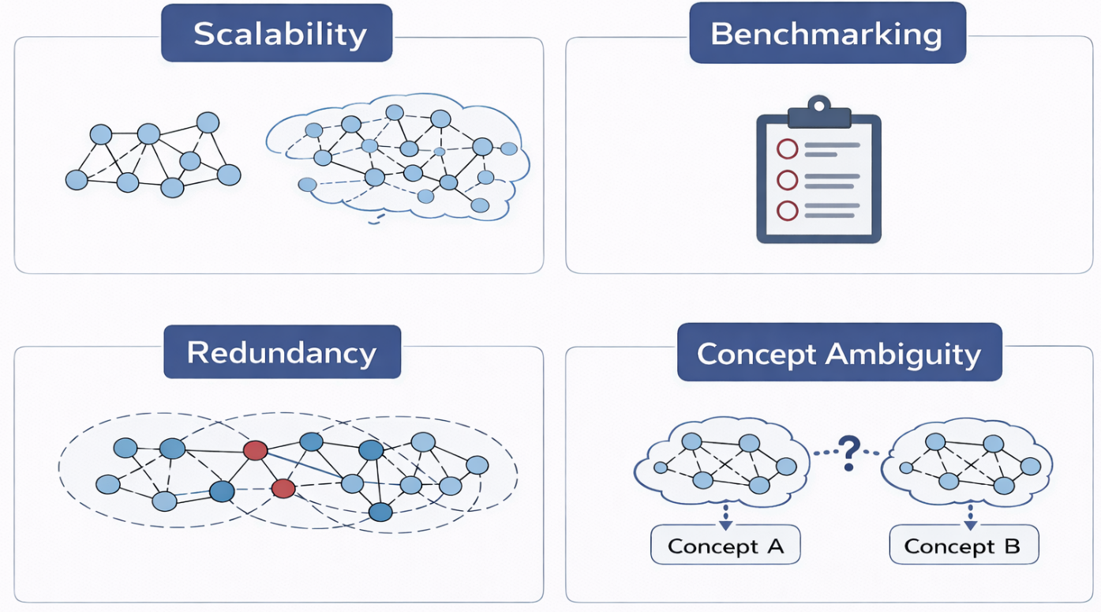
Challenges
Scalability of pattern mining: Exhaustive mining (gSpan, FSG, etc.) explodes with graph size and pattern size. Sufficiency/necessity checks require graph editing and re-evaluating the model many times.
Pattern redundancy: Many overlapping, slightly different patterns that mean the same thing.
Benchmarks: Few standard, widely-accepted metrics for concept-level explanations; how to measure if a concept is “good” (coherent, distinct, useful)?
Ambiguity: A subgraph might belong to multiple concepts or have context-dependent meaning.
30

Slide 31
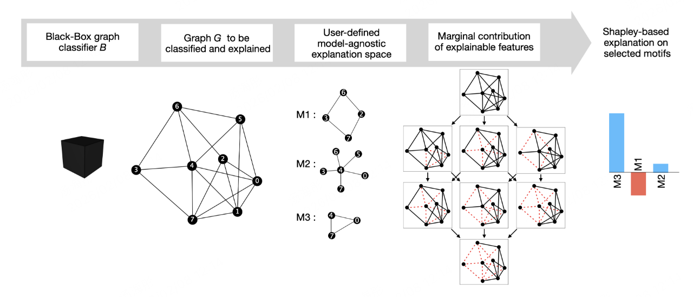
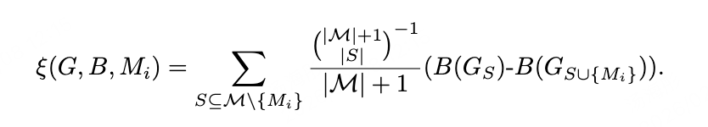
Pattern Mining: GRAPHSHAP [IJCNN 23]
Pattern (Motifs): They propose a pattern-based explanation language where a pattern is a motif—a small recurring subgraph structure—rather than explaining predictions with scattered individual edges.
GRAPHSHAP (Shapley Scoring): It decouples the model’s feature space (edges) from a human-readable motif space by masking/toggling motifs, querying the black-box classifier, and computing a Shapley-style contribution score for each motif to identify which structural patterns drive the decision.
31
Notes:
Alan Perotti, Paolo Bajardi, Francesco Bonchi, and André Panisson. 2023. Explaining Identity-aware Graph Classifiers through the Language of Motifs. In IJCNN. 1–8
GNNExplainer [27] provides an importance score for each node and each edge: this fine-grained style of explanation might possibly overwhelm with scattered information the user seeking an explanation, moreover it is not clear how nodes scores and edges scores relate to each other, and it is thus hard to imagine how to use them to assign an importance to motifs
in SubgraphX the explanation corresponds to a set of nodes and its induced subgraph, while GRAPHSHAP computes attribution scores, and therefore relative numerical importance, for an arbitrary set of motifs, that can be mined or user-defined
GRAPHSHAP can assign an importance score to any subgraph, spanning from a single edge to complex patterns, while SubgraphX is limited to the unique subgraph induced by a set of nodes.

Slide 32
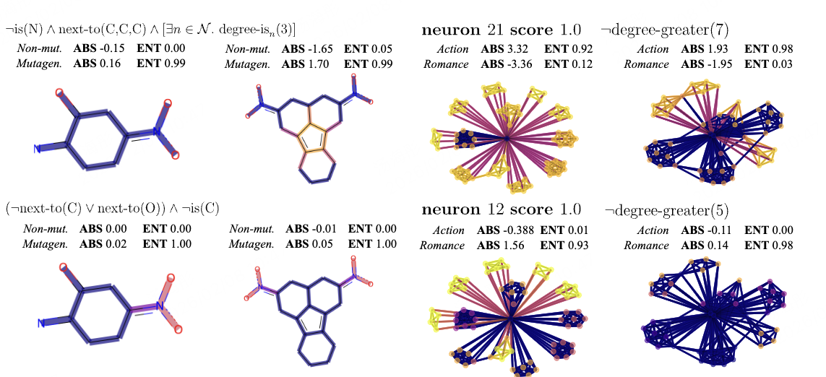
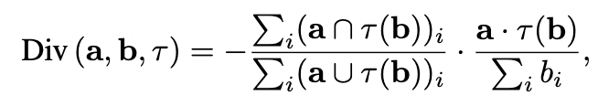
Global Concept-Based Interpretability [AAAI 23]
Concept Detectors: These interpretable neurons act as concept detectors, allowing the framework to explain what the model has learned at a global level, rather than just providing a local explanation for a single instance.
Quantifying Interpretability: The framework measures how well a neuron’s activation aligns with a target concept using an overlap-based score. The Div(·) objective includes an IoU-style intersection-over-union term (after thresholding activations by τ) to quantify neuron–concept consistency.
32
Notes:
Han Xuanyuan, Pietro Barbiero, Dobrik Georgiev, Lucie Charlotte Magister, and Pietro Liò. 2023. Global Concept-Based Interpretability for Graph Neural Networks via Neuron Analysis. In AAAI. 10675–10683
the first work which shows that GNN neurons act as concept detectors and have strong alignment with concepts formulated as logical compositions of node degree and neighbourhood properties
can disentangle the explanation into individual interpretable concepts backed by logical descriptions
We define a concept C to be interpretable if there exists a natural language description of C such that a practitioner is able to accurately predict the output of C given any graph G ∈ G from solely knowing this description. Hence, concepts such as nodes that have exactly one neighbour would be interpretable
the IOU score scaled by a factor representing how much of the activation signal is incorporated into the concept.

Slide 33
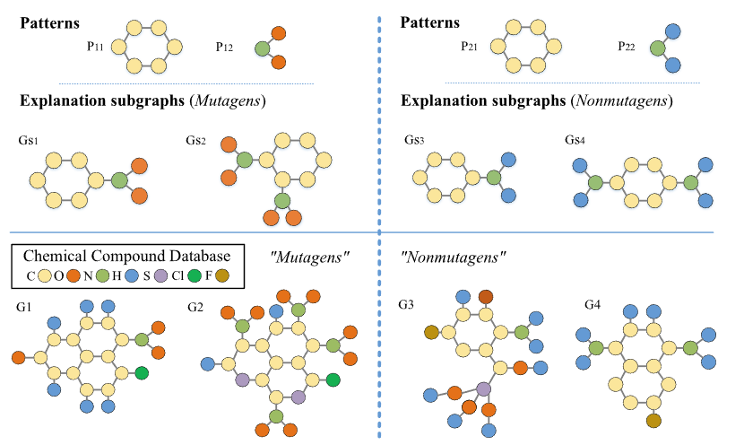

Our Work
Tingyang Chen, Dazhuo Qiu, Yinghui Wu, Arijit Khan, Xiangyu Ke, Yunjun Gao: View-based Explanations for Graph Neural Networks. Proc. ACM Manag. Data 2(1): 40:1-40:27 (2024)
GVEX [SIGMOD 24]: A two-tier explanation framework
Motivation:
(1) Large explanation subgraphs hinder explanibaility.
(2) Lack of meaningful explanations for domain experts, with limited queryability hindering access and inspection.
Pattern Matters!
GNN-based drug classification, with graph patterns and induced subgraphs that help
understand the results: ‘’which toxicophore occurs in mutagens?’’
33

Slide 34

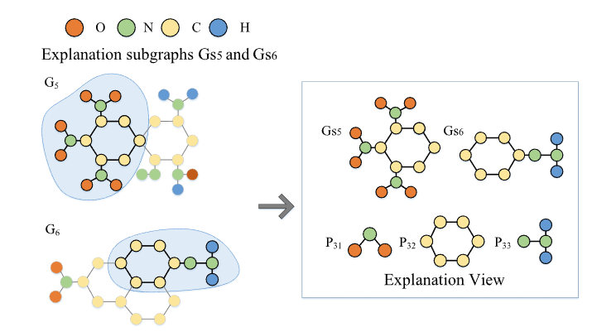
Our Work
GVEX [SIGMOD 24]: A two-tier explanation view framework^{[1]}
How to determine quality of explanation views
Explainability:
Coverage: Numbers of nodes
Efficient algorithm of Explanation View Generation Problem
Greedy, Approximation Algorithm
Streaming Extension and Paralllelization
feature influence
neighbor diversity
Lower-tier subgraphs: provide factual and counterfactual evidence
for predictions
Higher-tier patterns: abstract these subgraphs into common motifs to support efficient search, exploration, and domain alignment.
[SIGMOD 24] Tingyang Chen, Dazhuo Qiu, Yinghui Wu, Arijit Khan, Xiangyu Ke, and Yunjun Gao. 2024. View-based Explanations for Graph Neural Networks.

Slide 35
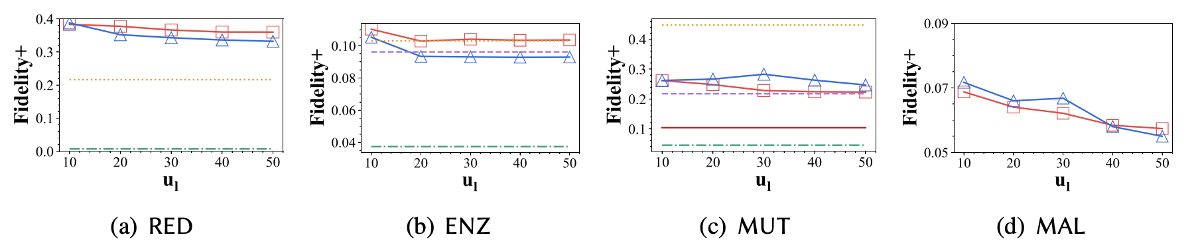
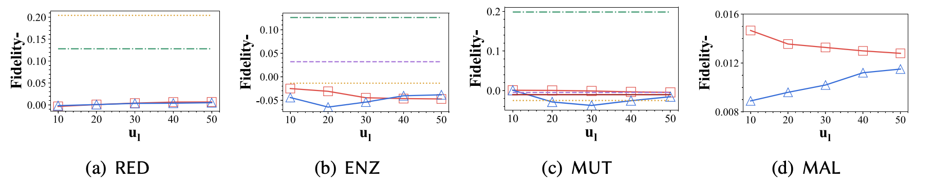
Our Work
Experiments:
Fidelity+(Higher is better), Fidelity-(Lower is better)
35

Slide 36
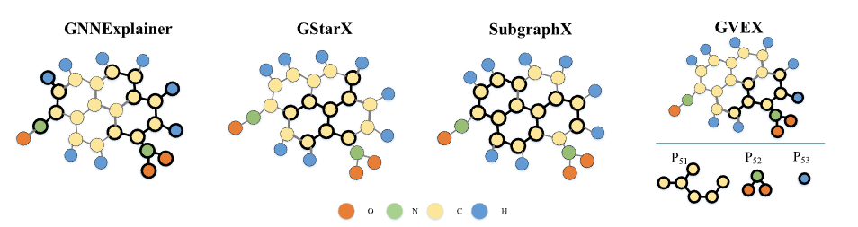
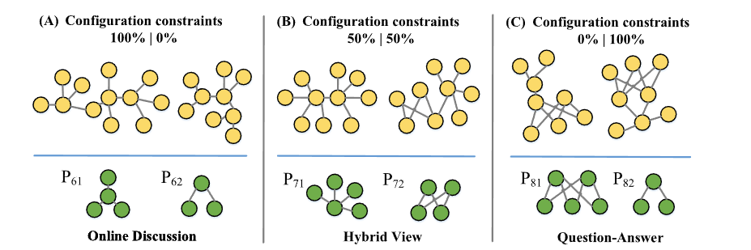
Our Work
Application (drug discovery, social networsk, etc.)
GNN-based social analysis: REDDITBINARY social network dataset, two classes - online-discussion threads and question-answer threads. Three different configuration scenarios.

Slide 37
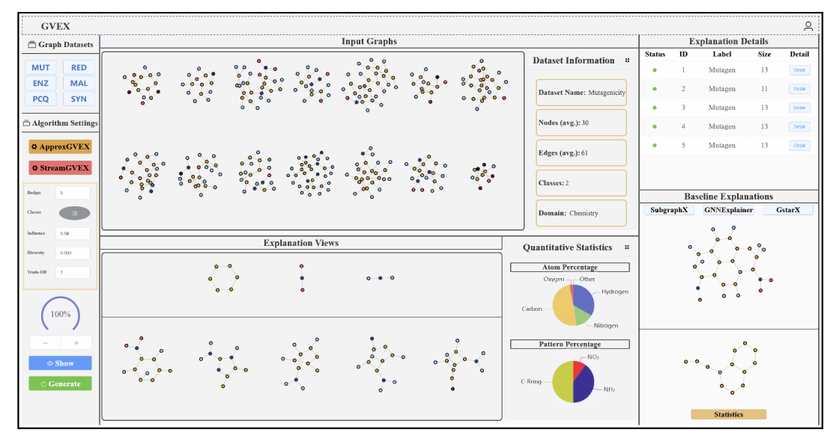
Interactiveness
GVEX-demo [SIGMOD’24]^{[1]}.
Visualizations
Case
Study
Statistics
Configuration
[SIGMOD 24] Tingyang Chen, Dazhuo Qiu, Yinghui Wu, Arijit Khan, Xiangyu Ke, and Yunjun Gao. 2024. User-friendly, Interactive, and Configurable Explanations for Graph Neural Networks with Graph Views.

Slide 38
Future Direction
In-training concept supervision: forces model internals to encode human-meaningful concepts so explanations align with what the model uses.
Transferable and domain-aligned concepts: concepts useful in one domain may fail in another; transferability is critical for reuse.
Human-centered explanations: build interactive viewers (hierarchy + prototypes + drill-down) and run small expert studies measuring usefulness for debugging or decision making
Bridging to language: domain experts prefer concise textual rationales tied to patterns
38
Notes:
111

Slide 39
Model-slicing Explanations
Xiangyu Ke
39

Slide 40
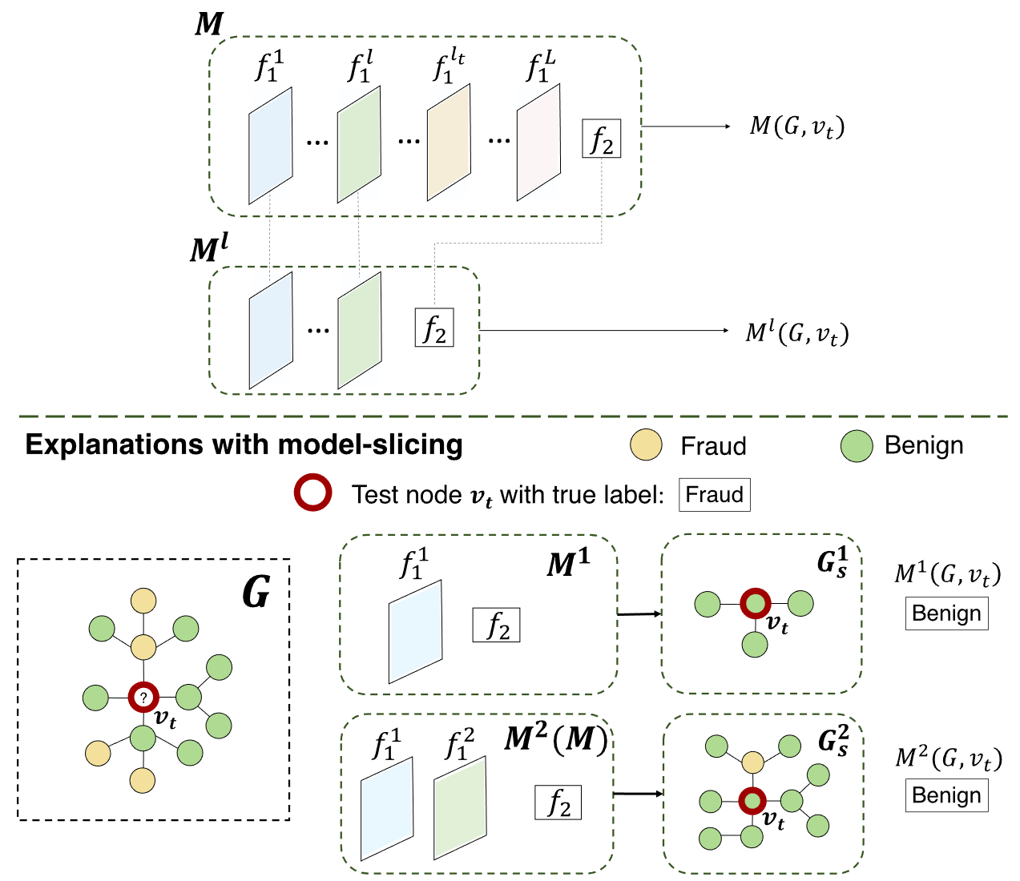
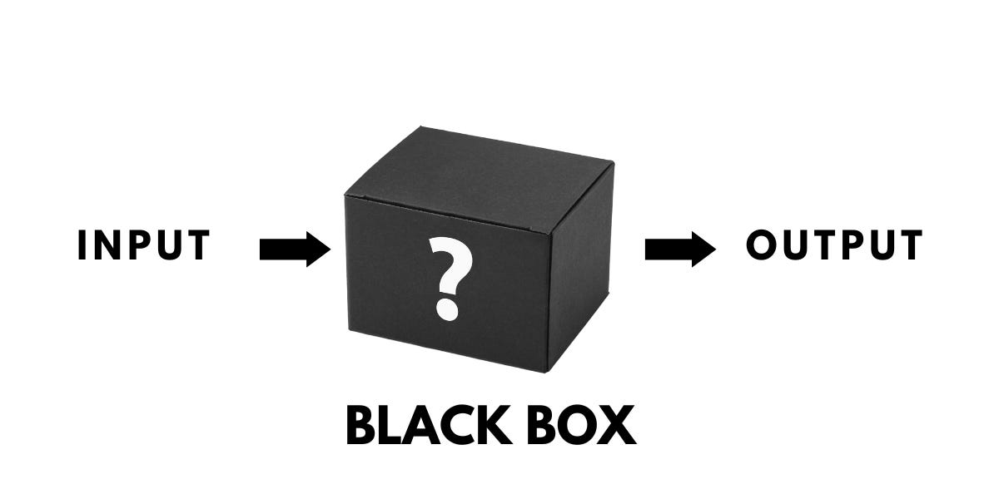
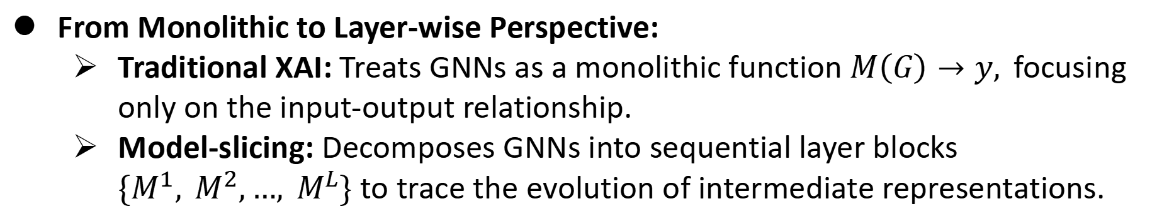
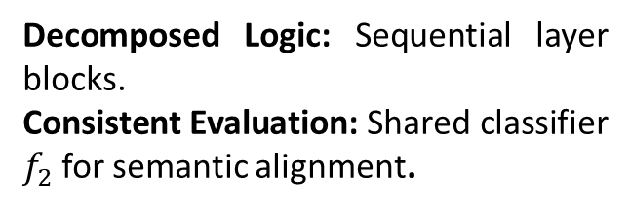
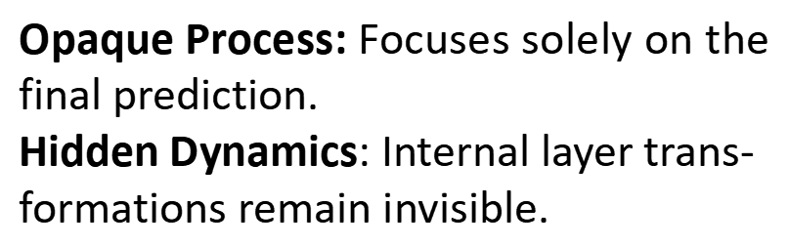
What is model-slicing?
From Monolithic to Layer-wise Perspective:
Traditional XAI: Treats GNNs as a monolithic function $M\left(G\right)→y,$focusing only on the input-output relationship.
Model-slicing: Decomposes GNNs into sequential layer blocks $\{M^{1}, M^{2},…, M^{L}\}$ to trace the evolution of intermediate representations.
Opaque Process: Focuses solely on the final prediction.
Hidden Dynamics: Internal layer trans-
formations remain invisible.
Decomposed Logic: Sequential layer blocks.
Consistent Evaluation: Shared classifier $f_{2}$for semantic alignment.
40

Slide 41
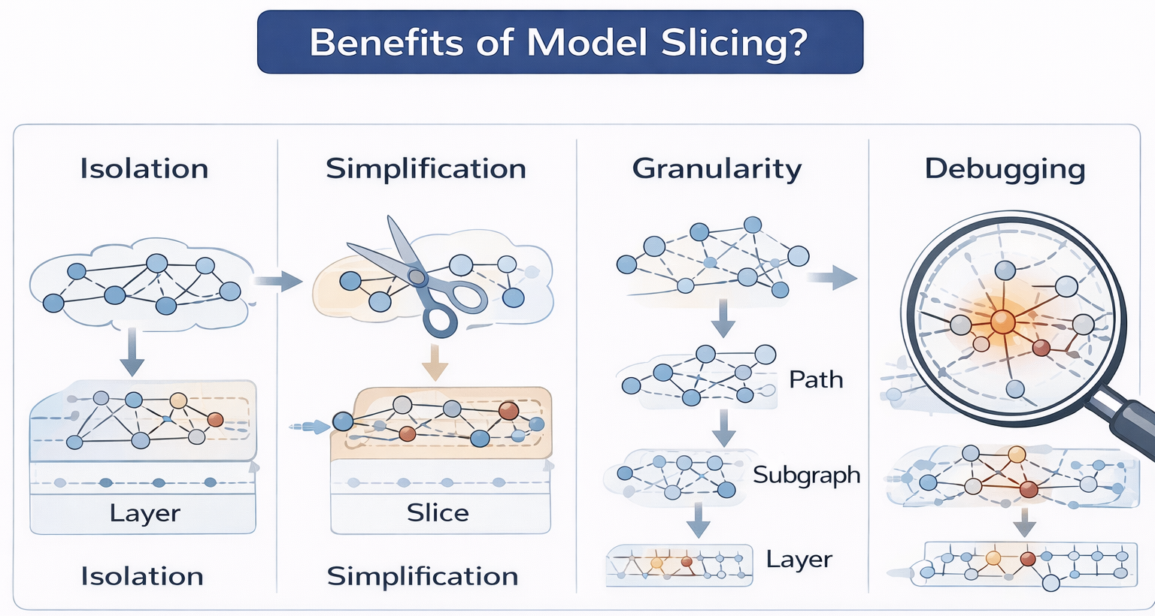
What model slicing buys you?
Isolates model-internal causes (message paths, neurons, layers) rather than only input motifs.
Yields compact, causally-testable explanations (ablate slice then observe change).
Supports multi-granular explanations (path, subgraph, neuron/channel, layer)
Helps debugging and model repair (pinpoint where bad behavior arises)
41

Slide 42
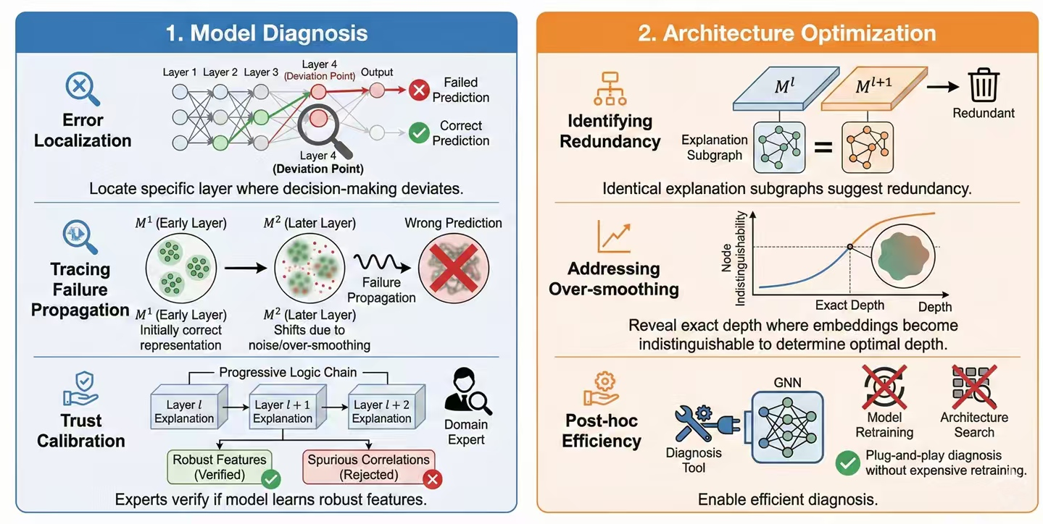
What model slicing buys you?
Key Applications:
Model Diagnosis: Pinpointing "When" and "Where“ by tracing layer-wise decision deviations to localize failure origins.
Architecture Optimization: Guidance for better design by quantifying structural redundancy to determine optimal model depth.

Slide 43
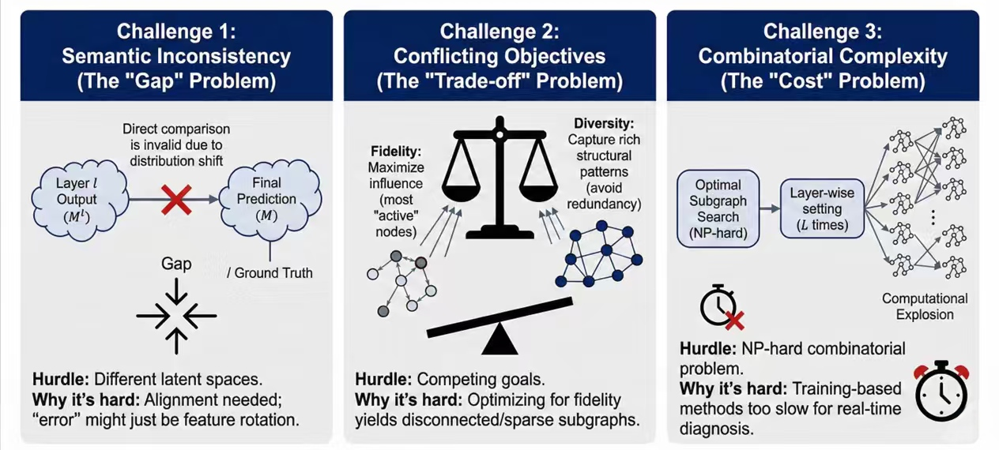
Why it is hard?
Challenges:
Semantic Inconsistency: Direct layer-wise comparison is invalid due to latent space misalignment and distribution shifts.
Conflicting Objectives: Balancing prediction fidelity and structural diver-sity is difficult, often yielding disconnected or non-semantic subgraphs.
Combinatorial Complexity: Layer-wise subgraph search is NP-hard, ren-dering iterative training-based methods computationally prohibitive for deep models.

Slide 44
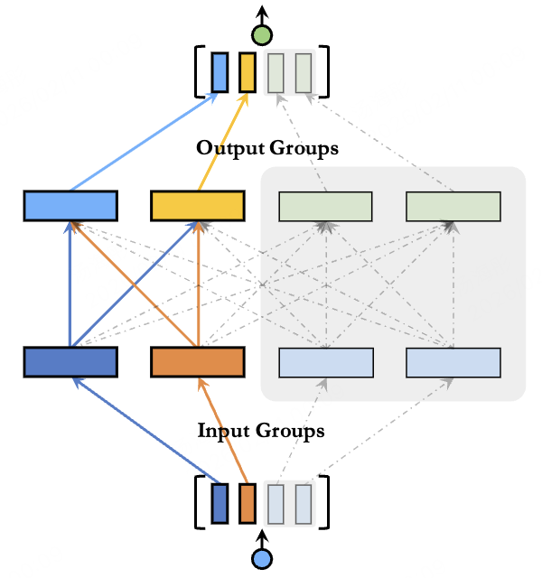
Existing Model Slicing Attempt [VLDB 19]
---- Model Slicing for Supporting Complex Analytics with Elastic Inference Cost and Resource Constraints
Motivation: Deep models used for complex analytics are often too heavy to run under fluctuating workloads and strict resource budgets, so we need a way to dynamically trade off accuracy and inference cost within a single model.
Model Slicing trains a network so that any prefix slice of each layer’s channels forms a valid sub-model. Concretely, channels in each layer are ordered by importance and shared across slices: a small slice uses only the first few channels, while a larger slice reuses them and adds more channels on top.
During training, the model is jointly optimized under multiple slice widths, so that at inference time the system can select an appropriate slice size on the fly according to current latency, FLOPs, or memory constraints, without retraining or switching models.
Left figure illustrates the core idea of model slicing: each layer is organized so that its channels can be sliced from left to right, yielding multiple nested sub-models.
Smaller slices (fewer channels) incur lower inference cost but reuse the same parameters as larger slices, which simply append additional channels for higher accuracy.
At runtime, the system chooses an appropriate slice according to the current resource budget.
44
Notes:
Cai S, Chen G, Ooi B C, et al. Model slicing for supporting complex analytics with elastic inference cost and resource constraints[J]. In VLDB, 2019, 13(2): 86-99.

Slide 45
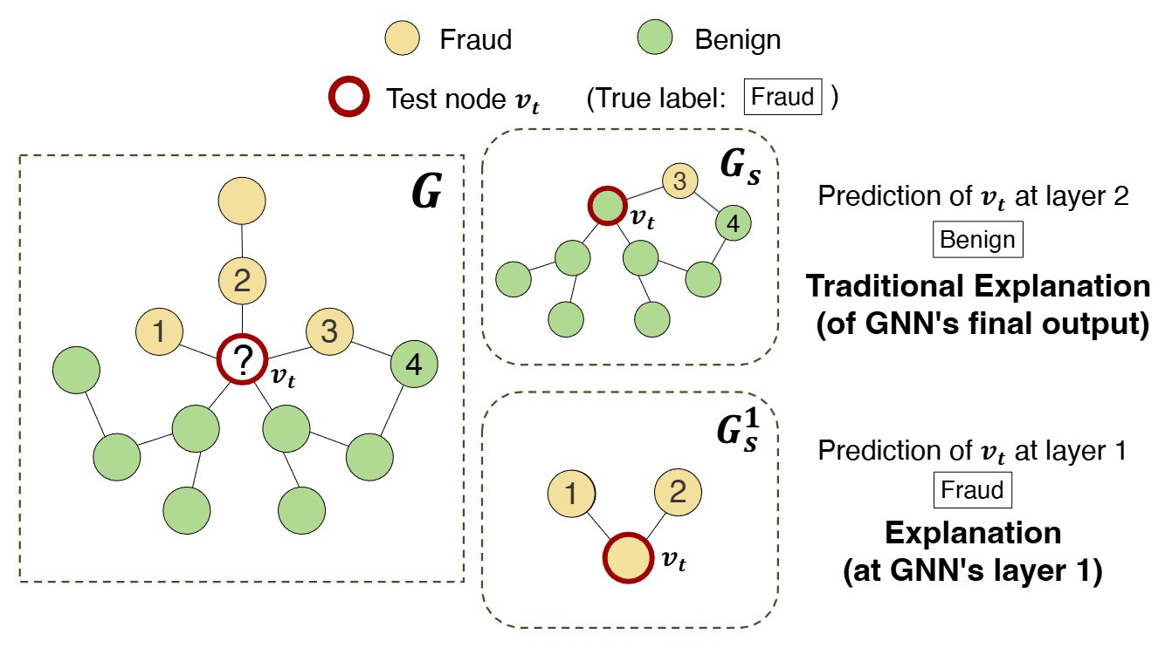
Our Work: SliceGX
Cibo Yu, Tingting Zhu, Tingyang Chen, Yinghui Wu, Arijit Khan, and Xiangyu Ke, "SliceGX: Layer-wise GNN Explanation with Model-slicing", in Proc. of The Web Conference 2026.
SliceGX [WWW 26]: A Layer-wise Progression
Motivation:
(1) Intermediate Opacity: Existing methods overlook how explanations evolve across layers.
(2) Diagnostic Gap: Unable to pinpoint which specific layer causes model failure.
Generating layer-wise explanations for GNN diagnosing for spam review
45

Slide 46

Our Work: SliceGX
SliceGX [WWW 26]: A Layer-wise Progression
Goal: To provide progressive, layer-wise explanations for model diagnosis and architecture optimization.
Model-Slicing: Decomposes GNNs into layer blocks to trace intermediate representation transformations.
Bi-criteria Metric: Optimizes both message-passing influence and embedding diversity to ensure high-quality, unbiased subgraphs.
Post-hoc Algorithms: Training-free generation with provable $\frac{1}{2}−$approximation guarantees for efficient discovery.
[2] Cibo Yu, Tingting Zhu, Tingyang Chen, Yinghui Wu, Arijit Khan, and Xiangyu Ke. WWW ’2026. SliceGX: Layer-wise GNN Explanation with Model-slicing.

Slide 47
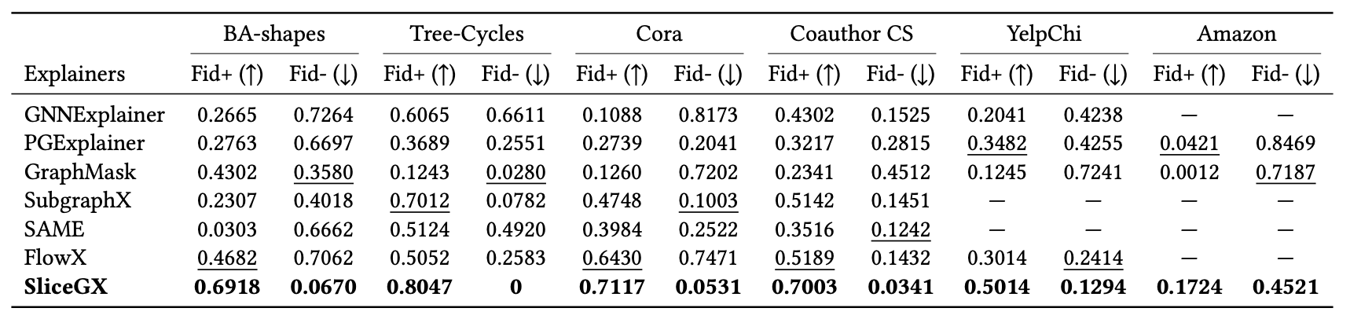
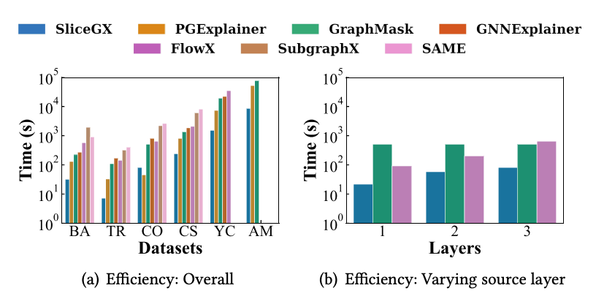
Our Work
Experiments:
Fidelity+(Higher is better), Fidelity-(Lower is better)
Efficiency
47

Slide 48
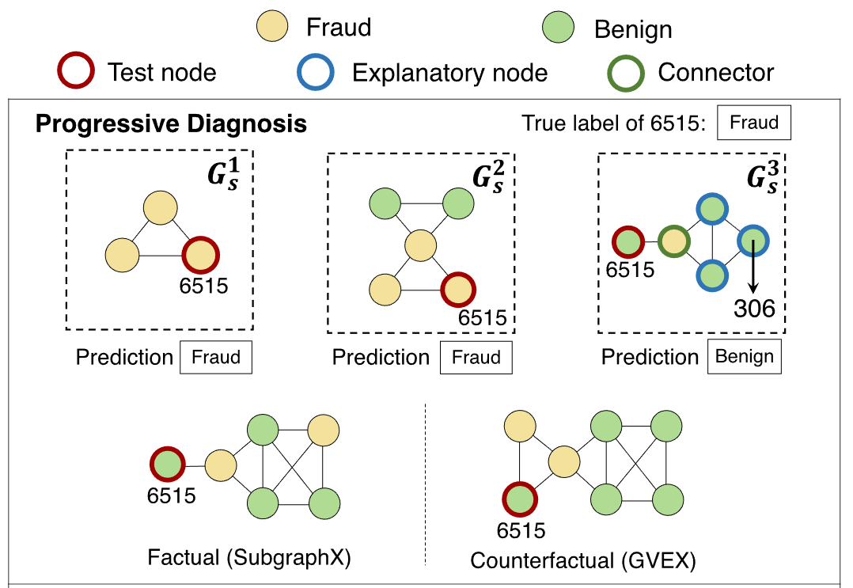
Our Work: SliceGX
Case study (progressive diagnose)
SliceGX reveals how a prediction is formed layer-by-layer, whereas SubgraphX and Gvex only show what the final result is.

Slide 49
Future Directions in Layer-wise XGNN
Transferability & cross-architecture slices: Slices useful across models (e.g., move from GAT to GCN) or datasets increases reusability.
Slice-driven compression and pruning : Slices reveal which paths/neurons are rarely used—useful for compression without harming task performance.
Fairness & privacy: Slices might expose sensitive patterns or amplify biases
Coalition-aware slices (for synergistic effects): Many decisions arise from joint contributions that single-element slices miss
Theoretical foundations: minimality, uniqueness, and approximation bounds: practitioners need guarantees: is a slice minimal/unique and how good are approximations?
Human-centered evaluation: explainability is useful only if humans understand and can act on slices.
49

Slide 50
Robust Explanation
Yinghui Wu
50

Slide 51
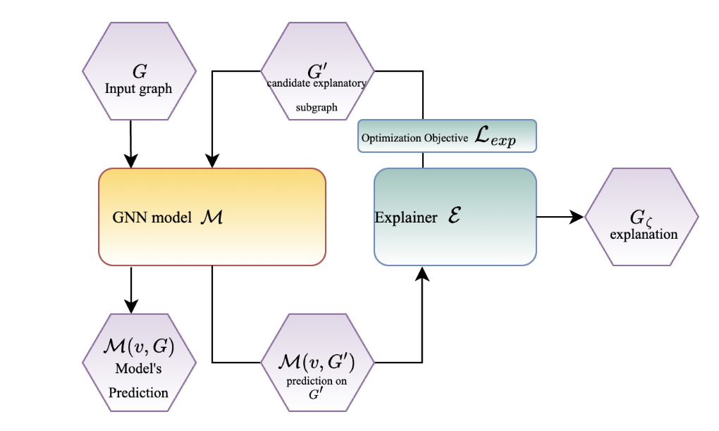
GNN Explanation: A general recipe
51

Slide 52
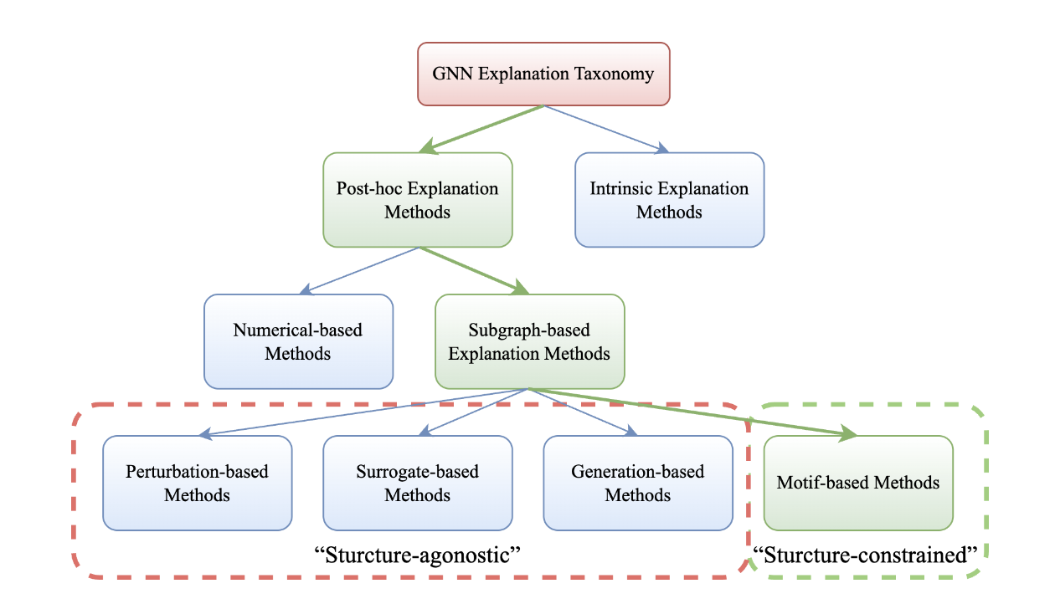
A taxonomy of SOTA GNN Explainers
52

Slide 53
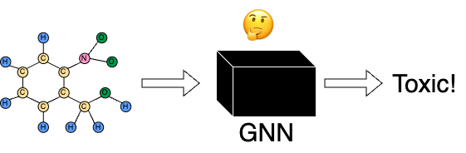
Robust GNN Explanation
Dazhuo Qiu, Mengying Wang, Arijit Khan, and Yinghui Wu, "Generating Robust Counterfactual Witnesses for Graph Neural Networks", in Proc. of IEEE International Conference on Data Engineering 2024.
“Black-Box” GNNs:
The inference of GNN models are black-box.
Hard to understand which part of the input causes the results.
“Explainability”:
Domain experts requires reliable predictions.
Highly related to trustworthy challenges.
53
Notes:
Robust Explanations – [Yinghui]
Multi-criteria Explanations – [Yinghui]

Slide 54
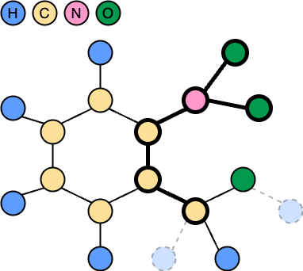
The need for Robust Explanation
Factual Explanation (Witness):
M(v, G) = M(v, G𝗌) = 𝑙
Counterfactual Explanation (CW):
M(v, G) ≠ M(v, G\G𝗌) ≠ 𝑙
Robust Explanation:
G𝗌 should remain a consistent, stable structure under various disturbance.
54

Slide 55
Multicriteria GNN Explanation
Factual Explanation (Witness):
M(v, G) = M(v, G𝗌) = 𝑙
Counterfactual Explanation (CW):
M(v, G) ≠ M(v, G\G𝗌) ≠ 𝑙
Robust Explanation (k-RCW):
G𝗌 remains
consistent under k-disturbance.
We should consider all three aspects
55

Slide 56
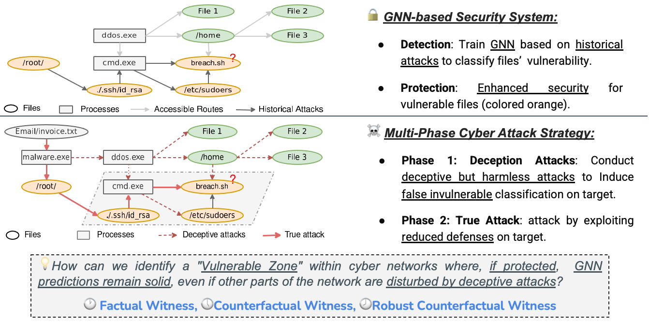
Need for Robust Explanations: Cyberattacks
Interpreting cyberattacks under agile attacking strategies
56

Slide 57
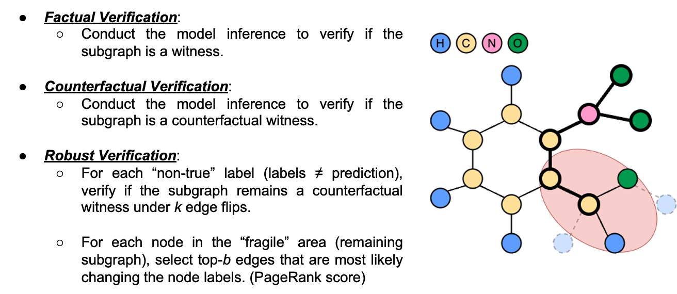
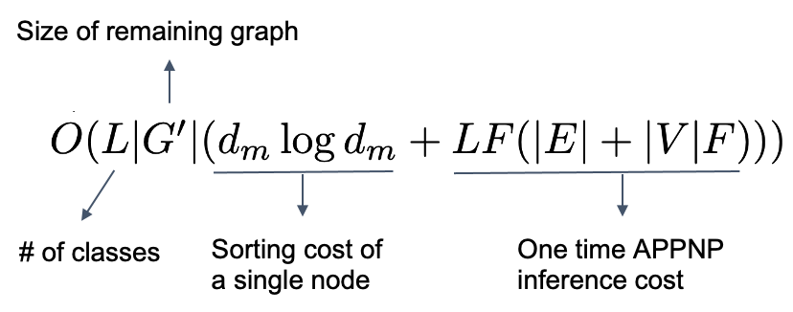
Verification problem
57

Slide 58
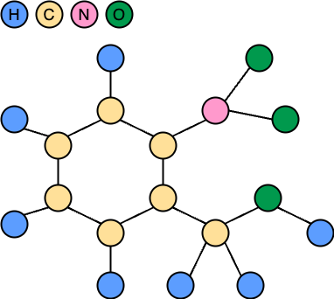
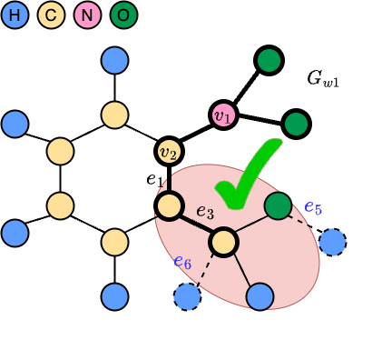






Generation problem
Expand:
Includes node pairs that most likely to change its label if “flipped”.
Augment the subgraph (initialized with test nodes) with edges that minimize the worst-case margin.
Verify:
Check if the expanded subgraph is RCW
Under k-disturbance: k edges that are most likely to change the prediction.
58

Slide 59



Experimental Evaluation
Normalized GED:
Robustness facilitates the consistency of the explanation under disturbance.
Fidelity+ and Fidelity-:
Verification procedure ensures a high fidelity performance.
Size:
RoboGExp integrate the explanation of each test node.
59

Slide 60

Effectiveness
60

Slide 61

Efficiency
61

Slide 62
End of First Half
62

Slide 63
Multi-goal Driven Explanation
Yinghui Wu
63

Slide 64
Interpreting GNNs: Why multi-criteria?
ML/AI Interpretability is task/user-specific
Single-metric explainers may produce one-sided, biased perspective
Call for multiple high-quality explanations capturing different trade-offs
Fidelity → large subgraphs, hard to inspect
Conciseness → small subgraphs, may miss important nodes
Counterfactual → informative but bloated explanations
Linear combinations are sensitive to weights and bias
64

Slide 65

Skyline Explanations: Pareto-Optimality
Return a set of non-dominated explanations
Each explanation is best in at least one metric
Users choose among diverse, high-quality options
65

Slide 66

CF2 (WWW 2022): Counterfactual & Factual Explanations
Goal: Learn explanations that are both factual and counterfactual
Jointly learns edge and feature masks
Optimizes weighted objective over factual + counterfactual reasoning
Strength: clear semantics for 'why' and 'what-if-not'
66

Slide 67



CF2: Intuition & Workflow
Workflow:
Input graph → learn masks → evaluate factual & counterfactual objectives
Output: one concise explanation subgraph
Limitation: single explanation; sensitive to weight tuning
67

Slide 68


PGExplainer (NeurIPS 2020): Parameterized Explainer
Goal: Learn a reusable explainer model for GNNs
MLP predicts edge importance conditioned on node embeddings
Strength: Trained once, generally applied to many nodes/graphs; fast inference-time explanations
68
Notes:
Illustration of PGExplainer for explaining GNNs on graph classification. (1) The left part demonstrates the explanation network. It takes node representations Z as well as the original graph Go asinputs to compute , the latent variables in edge distributions. Edge distributions are severed as the explanation. In case that an explanatory subgraph is wanted, we select top-ranked edges according to latent variables . (2) A random graph Gs is sampled from edge distributions and then feed to the trained GNN model to get the prediction Ys. (3) Parameter in the explanation network is optimized with cross-entropy between the original prediction Yo and the updated prediction Ys.

Slide 69

PGExplainer: Intuition & Workflow
Workflow:
Pretrain explainer → generate edge mask → extract subgraph
Optimizes mutual information with GNN predictions
Limitation: training bias affects quality; learning overhead
Approximation strategies: Use cross entropy H to approximate conditional entropy;
Use Monte Carlo to approximately optimize the object over a set of sampled graphs
69

Slide 70


MOExp (ICDM 2021): Multi-Objective Explanations
Goal: Pareto-optimal explanations over two objectives
Optimizes factual (simulatability) and counterfactual relevance
Returns a Pareto set instead of one explanation
Strength: exposes trade-offs explicitly
70

Slide 71

MOExp: Intuition & Workflow
Workflow:
Search subgraphs → evaluate two objectives → Pareto front
User inspects multiple explanations
Limitation: number of explanations can be large
71
Notes:
The workflow of finding Pareto optimal GNN explanations with high simulatability and counterfactual relevance. The subgraphs are
enumerated by DFS and the two objectives are computed on the enumerated explanations and their counterfactuals (Gi, ̃Gi) for each nodevi to be explained. Pareto optimal explanation (G∗i , ̃G∗i ) that are high (but not necessarily the highest) in both metrics are selected.

Slide 72
Comparison
CF2: factual + counterfactual via weighted objective → one explanation
PGExplainer: reusable parameterized explainer → fast, single, general-purpose objective
MOExp: Pareto front over two objectives → multiple explanations
Trade-off: expressiveness vs. scalability vs. inspection cost
72

Slide 73

SkyGExp (ICDE 2026): Skyline Subgraph Explanations
Goal: Pareto-optimal explanations over any k objectives
Learning-free, fast subgraph generation; scale to billion-level graphs
Returns a Pareto set instead of one explanation
Exposes trade-offs explicitly
Fraud detection, cybersecurity, drug discovery, and recommendation
Multiple perspectives = more trustworthy explanations
Interpretation is inherently multi-objective
Dazhuo Qiu, Haolai Che, Arijit Khan, and Yinghui Wu, "Interpreting Graph Inference with Skyline Explanations", in Proc. of IEEE International Conference on Data Engineering 2026.
73

Slide 74

Generation: Onion Peeling + Pareto Filtering
Start from L-hop neighborhood of the target node
Iteratively remove outer edges first (onion peeling)
Keep candidates that improve skyline dominance
Provable approximation guarantees for skyline quality
Early pruning via dominance relations
Parallel skyline explanations for large graphs
74

Slide 75

Evaluation: Effectiveness
75

Slide 76

Evaluation: Efficiency
76

Slide 77


Scalability and Case Analysis
Scaling to million-scale and billion-scale graphs
77

Slide 78
Declarative Explanation
Xiangyu Ke
78

Slide 79




Declarative Explanatory Queries
Graph Neural Networks excel at learning graph structures through message passing and feature aggregation, seeing widespread use in social networks, bioinformatics, and recommendation systems.
Recent work therefore shifts toward higher-level explanation units, highlighting a common need: users do not just want “an explanation,” but want to ask for explanations with specific targets, constraints, granularity, and purposes.
Declarative Explanatory Queries address this by providing a query-style interface—where users specify what they want to know and the system determines how to generate the corresponding explanation, enabling interactive, controllable.
79

Slide 80
Declarative Explanatory Queries
Benefits:
Task alignment & usefulness: Explanations match the user’s objective — debugging, auditing, regulatory reporting, or hypothesis testing — so they’re directly actionable.
Reproducibility & auditability: Explicit constraints and query parameters
Interactivity & composability: Queries can be iteratively refined
Resource-aware generation: Backends can honor resource or latency budgets stated in the query
Comparability & aggregation: The same query language enables fair comparisons across models, datasets, or classes and supports aggregate analyses
Challenges:
Specification design: Creating a language that is expressive yet usable is hard.
Objective trade-offs: Queries will often encode conflicting goals
Optimization complexity: Many useful query constraints lead to combinatorial search problems that are NP-hard in general.
Model and data variability: Stochastic models, randomized inference, or distribution shift can make query results unstable
Verification & guarantees: Users need confidence—how do we certify that a returned explanation satisfies the declared constraints, or how well it approximates the ideal objective?
79

Slide 81


Existing Declarative methods
---- Can I Trust the Explainer?Verifying Post-hoc Explanatory Methods [arXiv 19]
Motivation: Existing explainers are often compared without a clear "ground truth," making it impossible to know if we can truly trust their outputs on complex black-box models.
The Declarative Approach：The paper formalizes explainability by declaring specific perspectives (Feature-additivity vs. Feature-selection) and building a verification framework based on provable neural architectures. By designing models with explicit logical constraints (e.g., the Handshake mechanism), the "correct" explanation is declared by design, allowing for the first time a rigorous audit of post-hoc explainers.
Figure 2 illustrates the handshake problem: non-selected tokens may still influence the prediction via information encoded in the selected tokens, making feature-selection explanations unreliable.
80
Notes:
Camburu O M, Giunchiglia E, Foerster J, et al. Can I trust the explainer? Verifying post-hoc explanatory methods[J]. arXiv preprint arXiv:1910.02065, 2019.

Slide 82

Existing Declarative method
---- Towards Trustable Explainable AI [AAAI 20]
Motivation: Existing explainers are heuristic: they rely on local sampling and "guess" which features are important. They offer no guarantee that the explanation is valid across the entire model space, leading to a "Trust Gap."
The Declarative Approach：This work treats explainability as a formal verification task. Instead of sampling, we declare what a valid explanation must be: a minimal set of features that logically guarantees the model's prediction. By encoding the ML model into logical constraints (SAT/SMT), the system can prove that the explanation is correct.
The framework acts as a Reasoning Oracle that audits existing explanations:
Verify: It checks if a given explanation holds true for all possible inputs.
Repair: If an explanation is proven "invalid," the system uses logical reasoning to fix it.
Refine: If an explanation is "redundant," the system strips away unnecessary features to find the prime implicant (PI)—the most concise, provably correct reason.
In this context, Declarative XAI means defining an explanation by its logical requirements (what it must prove) rather than its computational heuristic (how it was sampled).
81
Notes:
Ignatiev A. Towards trustable explainable AI[C]. In AAAI. 5154-5158.

Slide 83


Overview of SliceGXQ [in submission]
SliceGXQ turns SPARQL-style queries into layer-wise GNN explanations. It interprets the query, slices the model, finds explanatory subgraphs, and verifies the results before visualizing them.
Back-end
The system performs query interpretation, then applies model slicing to focus on relevant layers/components, finds explanatory subgraphs, and verifies the explanation results.
Inputs
Users select a GNN model and a graph dataset from different data sources.
Query-based Interaction
Users submit a SPARQL-style request to specify what explanations or diagnostics they need.
Outputs
SliceGXQ returns
query-based explanations and model diagnosis with layer-wise information.

Slide 84



Core algorithms in SliceGXQ
Query-Driven Interaction
The introduction of a lightweight SPARQL-style interface empowers users to customize their explanation needs, making complex GNN internals accessible through simple, flexible queries.
The SliceGXQ query follows EXPLAIN(M, V_T) AT l_t FROM {G, L} WHERE P, k WITH mode,
where it specifies the target model and nodes, the layer to inspect, the dataset/layer scope, constraints (pattern/size), and the explanation mode.
Some SPARQL-style query examples
Layer-wise Insight
Unlike traditional "black-box" explainers, SliceGXQ provides deep, layer-specific insights, allowing users to trace how decision-making evolves across different GNN layers.
83

Slide 85

SliceGXQ Demonstration
Step 1 & 2 (Setup): Users first select a target graph dataset (e.g., YelpChi) and configure the GNN architecture (e.g., adding GCN layers) to be explained.
Layer-wise Explanations: The system outputs explanatory subgraphs for each layer (Layer 1–3), visualizing how the model's reasoning evolves and identifying critical features (e.g., distinguishing Fraud vs. Benign nodes).
Step 3 (Request): Users can either use Configuration Mode for direct parameter settings or Query Mode to issue flexible SPARQL-style queries (e.g., EXPLAN (GCN, {5571}) AT 3...), specifying the target node, layer, and diagnostic mode.
84

Slide 86
Natural Language Explanation
Xiangyu Ke
85

Slide 87

From Structural Subgraphs to Semantic Narratives
Definition:
Traditional XAI: Outputs a subgraph (e.g., a set of nodes/edges) which requires domain expertise to interpret.
Natural Language Explanations: Generates human-readable text that describes why the model made a decision, bridging the gap between graph data and human reasoning.
Data-centric $→$User-centric: Shifting focus from "what the model sees" (pixels/nodes) to "what the user understands" (language)

Slide 88

Why Natural Language Explanation is Vital?
From Binary to Narrative: Transitioning from providing raw subgraphs to generating human-readable reasoning.
Semantic Enrichment: Leveraging the vast world knowledge of LLMs to describe complex graph patterns in natural language.
Interactive Transparency: Enabling non-experts to understand model decisions through logical dialogue instead of technical masks.
87

Slide 89

Why it is hard?
Challenges:
(1) Linearizing complex graph topology into sequential text causes significant information loss and ambiguity.
(2) Aligning numerical GNN embeddings with semantic LLM vectors requires sophisticated projection mechanisms.
(3) Ensuring explanations strictly reflect GNN logic, avoiding hallucinations driven by LLM prior knowledge.

Slide 90

Evolution of NL-XGNN: From Templates to Deep Alignment
Phase 1: Template-based Generation (Modular).
Phase 2: Tuning-free Prompting (Pipeline).
Phase 3: Deep Latent Alignment (End-to-End).
89

Slide 91


Natural Language Explanations
Evidence-to-Language Translation: Converting technical counterfactual instances into human-readable narratives.
Modular Integration: A plug-and-play approach compatible with any state-of-the-art counterfactual explainer
User-Centric Refinement: Utilizing LLMs to bridge the gap between abstract graph changes and domain-specific reasoning.
[arXiv 24] Giorgi, F., Campagnano, C., Silvestri, F., & Tolomei, G. Natural language counterfactual explanations for graphs using large language models.

Slide 92

Natural Language Explanations
Embedding Projection: Projecting GNN node embeddings directly into the LLM's embedding space for deep alignment.
Hybrid Narrative Prompting: Interleaving "soft prompts" (GNN internal states) with "hard prompts" (textual graph structure).
Joint Subgraph & Rationale Generation: Simultaneously producing a concise explanation subgraph and a detailed natural language rationale.
[arXiv 25] Baghershahi, P., Fournier, G., Nyati, P., & Medya. From Nodes to Narratives: Explaining Graph Neural Networks with LLMs and Graph Context.

Slide 93

Natural Language Explanations
Saliency-to-Text Mapping: Converting technical saliency scores into natural language reasoning.
Expert Iteration Loop: Refining LLM outputs through iterative pseudo-label generation to ensure faithfulness.
Explanation Consistency: Aligning generated narratives with the underlying GNN's decision logic.
[ACL 25] Pan, B., Xiong, Z., Wu, G., Zhang, Z., Zhang, Y., Hu, Y., & Zhao, L. Graphnarrator: Generating textual explanations for graph neural networks.

Slide 94

Future Directions in Natural Language Explanations
Direction 1: From Monologue to Dialogue (Conversational XAI).
Direction 2: Certified Faithfulness (Solving Hallucination)
Direction 3: Unified Graph-Text Pre-training (Foundation Models)
93

Slide 95
Counterfactual Explanation
Arijit Khan
94

Slide 96
Finding Counterfactual Evidences for Node Classification
Node classification with Graph Neural Networks (GNNs):
Predicting labels for nodes in a graph by leveraging both node features and graph structure.
Counterfactual learning:
The possibility of an alternative outcome if some of the premises were different from what were in reality (“counter to the facts”).
GNN’s limitations on high-stakes application domains:
Lack interpretability and tend to inherit dataset biases, causing discriminatory decisions on sensitive attributes.
Dazhuo Qiu, Jinwen Chen, Arijit Khan, Yan Zhao, and Francesco Bonchi, "Finding Counterfactual Evidences for Node Classification", KDD 2025
Paper: https://arxiv.org/abs/2505.11396
Codes: https://github.com/DazhuoQ/Counterfactual_Evidence

Slide 97

Counterfactual Evidence vs. Counterfactual Explanation
96

Slide 98
Counterfactual Evidence
The need for counterfactual evidences:
Avoid perturbing the dataset, as it may produce infeasible or unrealistic counterfactuals based on unobservable data.
Problem definition:
Given a node v from the test node set, another node u is called its counterfactual evidence (CE) if the following two conditions hold:
𝑣 and 𝑢 are assigned different labels by model 𝑀: 𝑀(𝑣)≠𝑀(𝑢);
L-hop neighbor subgraphs of 𝑣 and 𝑢 have a high similarity score, e.g., Kernel-based Similarity Score or 𝐾𝑆(𝑣, 𝑢).
97

Slide 99

Kernel-based Similarity Search
98

Slide 100
Top-1 Local & Global Counterfactual Evidences
Top-1 Local Counterfactual Evidence:
Given a query node 𝑣, the top-1 local CE is a node 𝑢 that:
has a different predicted label w.r.t. 𝑣;
attains the highest similarity score 𝐾𝑆(𝑣, 𝑢) compared to all other nodes in the test set.
Top-1 Global Counterfactual Evidence:
Given a test set, the top-1 global CE is a pair of nodes (𝑣, 𝑢) such that:
𝑣 and 𝑢 have different predicted labels;
the pair has the highest similarity score 𝐾𝑆(𝑣, 𝑢) among all possible node pairs in the test set.
99

Slide 101

Algorithm: Supplementary Partitioning
100

Slide 102

Algorithm: Weighted Clustering
101

Slide 103

Algorithm: LocalCE-B&I
102

Slide 104

Algorithm: GlobalCE-B&I
103

Slide 105

Experiments: Settings
104

Slide 106

Experiments: Effectiveness & Generalizability
105

Slide 107

Experiments: Efficiency & Scalability
106

Slide 108

Applications: Revealing Unfairness of GNNs
Node features and their discrimination scores (DS) considering GCN [ICLR17] and FairGNN [WSDM21]: Bail dataset.
107

Slide 109

Applications: Verifying Prediction Errors
108

Slide 110

Applications: Fine-tuning with CE
109

Slide 111
ATEX-CF: Attack-Informed Counterfactual Explanations for GNNs
GNNs excel at node classification but remain opaque in critical domains (healthcare, finance, scientific discovery).
Counterfactual explanations answer: "What must differ for a different outcome?"
→ Identify minimal graph changes that flip a model's prediction.
Problem: Existing counterfactual methods rely almost exclusively on edge deletions (E⁻).
→ They overlook missing relations (E⁺) whose addition could substantially alter predictions.
Meanwhile: Adversarial attacks on GNNs demonstrate that adding just 2–5 edges can flip node predictions!
Yu Zhang, Sean Bin Yang, Arijit Khan, Cuneyt Gurcan Akcora, "ATEX-CF: Attack-Informed Counterfactual Explanations for Graph Neural Networks", ICLR 2026
Paper: https://arxiv.org/abs/2602.06240
Codes: https://github.com/zhangyuo/ATEX_CF

Slide 112
ATEX-CF: Attack-Informed Counterfactual Explanations for GNNs
Key Question: Can we unify adversarial attacks with counterfactual explanationsto produce better, more comprehensive explanations?
111

Slide 113
Counterfactual Explanations vs. Adversarial Attacks
 | Counterfactual Expl. | Adversarial Attack
Goal | Explain prediction | Cause misclassification
Primary Operation | Edge deletion (E⁻) | Edge addition (E⁺)
Constraint | Minimal & plausible | Small budget κ
Shared Effect | Both flip the GNN prediction
Adversarial Attack:
Adds new edges
Reveals which missing relations could alter the outcome
Counterfactual (CF):
Removes existing edges
Reveals which relations support the current prediction
⟹ Complementary perspectives on the same graph!
112

Slide 114

Case Study: Limitations of Deletion-Only Methods
Loan Decision Dataset:
Loan approval requires: income > 5 AND degree > 3
Alice: income = 6 (✓), degree = 3 (✗)
Model predicts: Rejected
What happens?
Deletion-based CF: Removing edges further reduces degree → Fails!
Unconstrained addition: Link to billionaire → Succeeds but implausible
ATEX-CF: Identifies a feasible peer connection → Flips prediction & plausible!
Deletion-based methods cannot help Alice; ATEX-CF finds a realistic edge addition.
113

Slide 115
Theoretical Foundation: Bridging Attacks & Explanations
Hypothesis: The edges added by a successful evasion attack overlap with the most influential edges in a counterfactual explanation.
Formal Statement For target node v, let ΔG(E⁺) be the attack-added edges that flip model f's prediction,and CFEx(G) the counterfactual explanation subgraph. Then: Sim( ΔG(E⁺), CFEx(G) ) is high
Implications:
Attack-added edges are natural counterfactual candidates
Attack methods provide efficient search over the combinatorially large space of possible edge additions
Supported by gradient-based reasoning and empirical similarity measures
⟹ This motivates integrating attack semantics into counterfactual generation.
114

Slide 116

ATEX-CF: Framework Overview
End-to-end workflow: Original graph → Attack candidates → Candidate set S = S⁻ ∪ S⁺ → Joint optimization → Counterfactual graph
115

Slide 117
Joint Optimization: Three-Objective Loss
min L(ΔA) = λ₁ · L_{pred} (Impact) + λ₂ · L_{dist} (Sparsity) + λ₃ · L_{plau} (Plausibility)
Impact (L_{pred})
Push prediction away from
original class until flip occurs.
Uses NLL loss with indicator function; Set zero once flipped.
Sparsity (L_{dist})
Minimize ‖ΔA‖₀: total
number of edge edits.
Keeps modified graph close to original for interpretability.
Plausibility (L_{plau})
Penalizes unnatural changes:
α_{deg} · DegAnom
+ α_{motif} · MotifViol
Prevents implausible
degree/clustering jumps.
Balances effectiveness (flip prediction) with realism (sparse & plausible edits)
116

Slide 118
Candidate Selection
Candidate Set Construction:
S⁻ (Deletions): Local structure — existing edges in (l+1)-hop neighborhood of target node v
S⁺ (Additions): Edges from adversarial attack (GOttack) — identifies influential nodes via graph orbit structure
S = S⁻ ∪ S⁺
Final subgraph of target node v:
A_{v} = AG_{v} (local) + ΔA_{attack} (adversarial)
117

Slide 119
Signed-Mask Perturbation
Signed-Mask Perturbation:
Each candidate edge e gets continuous mask
Mₑ ∈ [-1, 1]:
Mₑ > 0: addition
Mₑ < 0: deletion
Mₑ ≈ 0: no change
Forward: Discretize to {-1, 0, +1} via thresholding and Top-κ edits for sparsification
Backward: Straight-Through Estimator (STE) enables gradient flow
Post-hoc pruning: Greedy removal of redundant edges to ensure minimality
118

Slide 120


ATEX-CF Algorithm
119

Slide 121
Experimental Results: Meta-Ranking Across 6 Datasets
Datasets: BA-Shapes, Tree-Cycles, Loan-Decision (synthetic); Cora, Chameleon, ogbn-Arxiv (real)
GNNs: GCN, GAT, Graph Transformer | Budget: κ = 5
Method | Misclass.↓ | Fidelity↓ | ΔE ↓ | Plausib.↓ | Time↓ | Avg Rank | Wins
CF-GNNExplainer | 4.7 | 4.8 | 2.0 | 2.3 | 9.5 | 4.67 | 1
INDUCE | 6.3 | 6.8 | 4.5 | 7.8 | 2.8 | 5.67 | 1
C2Explainer | 5.0 | 6.2 | 5.7 | 5.8 | 8.7 | 6.27 | 1
GNNExplainer | 6.8 | 7.5 | 4.7 | 5.5 | 3.3 | 5.57 | 1
PGExplainer | 8.2 | 7.7 | 4.2 | 5.8 | 1.0 | 5.37 | 6
Nettack | 3.3 | 2.5 | 8.8 | 8.0 | 4.5 | 5.43 | 2
GOttack | 4.8 | 4.3 | 8.8 | 8.0 | 3.0 | 5.80 | 0
ATEX-CF (Ours) | 1.2 | 1.3 | 1.0 | 1.2 | 7.3 | 2.40 | 20

Slide 122
Experimental Results: Meta-Ranking Across 6 Datasets
Datasets: BA-Shapes, Tree-Cycles, Loan-Decision (synthetic); Cora, Chameleon, ogbn-Arxiv (real)
GNNs: GCN, GAT, Graph Transformer | Budget: κ = 5
Method | Misclass.↓ | Fidelity↓ | ΔE ↓ | Plausib.↓ | Time↓ | Avg Rank | Wins
CF-GNNExplainer | 4.7 | 4.8 | 2.0 | 2.3 | 9.5 | 4.67 | 1
INDUCE | 6.3 | 6.8 | 4.5 | 7.8 | 2.8 | 5.67 | 1
C2Explainer | 5.0 | 6.2 | 5.7 | 5.8 | 8.7 | 6.27 | 1
GNNExplainer | 6.8 | 7.5 | 4.7 | 5.5 | 3.3 | 5.57 | 1
PGExplainer | 8.2 | 7.7 | 4.2 | 5.8 | 1.0 | 5.37 | 6
Nettack | 3.3 | 2.5 | 8.8 | 8.0 | 4.5 | 5.43 | 2
GOttack | 4.8 | 4.3 | 8.8 | 8.0 | 3.0 | 5.80 | 0
ATEX-CF (Ours) | 1.2 | 1.3 | 1.0 | 1.2 | 7.3 | 2.40 | 20
Average ranks (↓) across 6 datasets (lower = better); Wins out of 30 metric–dataset cells
⟹ ATEX-CF wins 20/30 cells; best overall rank 2.40 vs. 4.67 for the runner-up

Slide 123

Budget Sensitivity & Key Findings
Performance vs. perturbation budget κ on Cora (GCN)
Key Observations:
ATEX-CF consistently outperforms all baselines across budgets κ = 1 … 15
Edit size of ATEX-CF grows mildly with κ; attack baselines must exhaust all allowed edits
Ablation: Each loss component is essential — removing L_{dist} or L_{plau} degrades performance
Pruning reduces edits (1.71→1.62) with no accuracy loss
Asymmetric costs: Controllable trade-off between E⁺ and E⁻ via cost weight C
122

Slide 124
Summary of Contributions
1. Unified Perspective: First theoretical bridge between adversarial attacks and counterfactual explanations in GNNs — attack edge additions serve as counterfactual candidates.
2. Hybrid Framework (ATEX-CF): Jointly leverages edge deletions (traditional CF) and attack-informed edge additions for more comprehensive explanations.
3. Enhanced Explanatory Coverage: Uncovers missing but plausible relations, complements deletion-based methods, and enables proactive graph modifications.
4. Efficiency & Controllability: Attack-guided candidate selection reduces combinatorial complexity; sparsity + plausibility constraints ensure realistic explanations.
5. State-of-the-Art Results: Wins 20/30 metric–dataset cells across 6 benchmarks, 3 GNN architectures, and 9 baselines.
123

Slide 125

GNN Explainers 2.0: User-centric and Data-driven
Explanations for end-users and domain experts
Layer-wise provenance for model debugging and optimization
Interactive, configurable, efficient, and scalable explanations
Robust and multi-criteria optimization explanations
Explanatory query and output interface based on structured query, natural language, and examples
124

Slide 126
Tutorial outline
1 Introduction
2 GNN Explainers Categorization
3 GNN Explainers 2.0
4 User-centric and Data-driven Explainability Methods for GNNs
5 Future directions
5.1 Downstream Tasks beyond Classification
5.2 Qualitative Evaluation of GNN Explanation
5.3 Explainability for Complex GNNs
5.4 Explanation with Privacy Concern
5.5 Explanation as Actionable Recourse
5.6 Multi-modal Explanation
125

Slide 127
Future Directions
Arijit Khan
126

Slide 128

Downstream Tasks Beyond Classification
Benchmarking interplay of GNN models, graph data, explainability methods, evaluation metrics, and downstream tasks.
Downstream tasks beyond graphs and nodes classification.
- Link prediction/ recommendation
- Question answering
- Network alignment
- Task-agonistic GNN explanation
Downstream Task
Graph Data
GNN Models
Evaluation of GNN Performance
GNN Explainability Methods
Evaluation of GNN Explainability Methods
Paper: https://arxiv.org/abs/2508.04731
The NAEx framework for Network Alignment Explanation
NAEx: A Plug-and-Play Framework for Explaining Network Alignment. Shruti Saxena, Arijit Khan, Joydeep Chandra
127
Notes:
128

Slide 129

Qualitative Evaluation of GNN Explanation
Qualitative evaluation of GNN interpretation – usability, interactive-ness, querying with domain knowledge, trustworthiness, deployment, visualization and HCI tools.
Obtain real-world ground truth.
A human-centered approach toward offering GNN explanations must include human-intelligible visualizations, a user interface facilitating human interactions with visualized explanations, and finally allow human input during or immediately following such evaluation to refine either the GNN model, explainer, or both.
Paper: https://arxiv.org/abs/2405.06917
Pantea Habibi, Peyman Baghershahi, Sourav Medya, Debaleena Chattopadhyay: Design Requirements for Human-Centered Graph Neural Network Explanations.
128
Notes:
129

Slide 130


Explainability for Complex GNNs
Explainability for more complex graph neural networks, e.g., hypergraph neural networks, temporal graph neural networks, graph transformers, graph foundation models, and Graph RAG.
Graph Foundation Model
Graph-based Retrieval-augmented Generation
(Graph RAG)
129
Notes:
130

Slide 131

Explanation with Privacy Concern
Privacy and explainability → two important ingredients for trustworthy ML.
Balance explanation quality with data and model privacy.
Iyiola E. Olatunji, Mandeep Rathee, Thorben Funke, Megha Khosla. Private Graph Extraction via Feature Explanations. Proc. Priv. Enhancing Technol. 2023 https://petsymposium.org/popets/2023/popets-2023-0041.pdf
The importance scores for the features, as provided by an explanation, can be exploited to infer the graph structure
Megha Khosla. Privacy and Transparency in Graph Machine Learning: A Unified Perspective. https://arxiv.org/pdf/2207.10896
130
Notes:
131

Slide 132

Explanation as Actionable Recourse
Counterfactual explanation to offer actionable recourse.
Alignment with specific domain constraints. Contextually relevant, practical, and interpretable explanations.
In drug discovery, an identified molecular fragment might be nonexistent or unstable under laboratory conditions.
Statistical significance of deviations in the number of connected graphs between the test set and their corresponding counterfactual explanations on molecular datasets. Statistically significant deviations with p-value< 0.05 are highlighted.
GNNX-BENCH: Unravelling the Utility of Perturbation-based GNN Explainers through In-depth Benchmarking
Mert Kosan, Samidha Verma, Burouj Armgaan, Khushbu Pahwa, Ambuj Singh, Sourav Medya, Sayan Ranu. ICLR 2024
https://arxiv.org/pdf/2310.01794
131
Notes:
132

Slide 133

Multi-modal Explanations
In healthcare and spatio-temporal analysis, data are multi-modal—comprising text, images, tables, and multimedia.
Graph-based models, like knowledge graphs, offer integrated solutions for multi-modal data.
GNN-LLM collaborative systems can process and generate outputs across these modalities.
Multimodal Explanations: Justifying Decisions and Pointing to the Evidence. Dong Huk Park , Lisa Anne Hendricks, Zeynep Akata , Anna Rohrbach, Bernt Schiele, Trevor Darrell, and Marcus Rohrbach
https://arxiv.org/abs/1802.08129
132
Notes:
133

Slide 134

Thanks!
Website - https://gnn-explainers.github.io/
arijitk@bgsu.edu; xiangyu.ke@zju.edu.cn; yxw1650@case.edu;
bonchi@gmail.com
Thanks for Website Setup and Logo Design!
Mengying Wang mxw767@case.edu
133
Notes:
134

